Slide 1
An interactive evaluation of a mentoring program for beginning teachers
Thao Vu
Phuong Ngo

Slide 2
About the researchers and the research context
Teachers from University of Languages and International Studies – Vietnam National University, Hanoi
2007: formal mentoring programs for beginning EFL teachers have been absent for a decade at the Faculty of ELT Education, ULIS, VNU-HN.
Newly recruited teachers are assigned to conduct English lessons for TEFL majors on their own without any official guidance immediately after recruitment.

Slide 3
About the researchers
Researchers:
Teachers
Academic Manager
Coordinator of R&D Activities for young teachers in FELTE
Understand the concerns over the performance, job satisfaction and turnover of young teachers
Recognise the needs of beginning teachers to receive formal professional induction
2009: a plan for a mentoring program for beginning teachers developed in Division 2
2010-2011: implementation of the program in Division 2
Now: evaluation for improvement of the program

Slide 4
Research questions
Interactive evaluation approach suggested by Owen (2006)
What was the program trying to achieve?
Was the delivery working?
Was delivery consistent with the program plan?
What can be done to improve the program for the future?

Slide 5
outline
THEORETICAL BACKGROUND
DESCRIPTION OF THE MENTORING PROGRAM
RESEARCH METHODOLOGY
RESEARCH RESULTS AND DISCUSSION
CONCLUSION

Slide 6
THEORETICAL BACKGROUND

Slide 7
Mentoring beginning teachers broad definition
A student of teaching
A teacher of students
(Smith & Ingersoll, 2004, p. 683).

Slide 8
Mentoring beginning teachers Definition
MENTORING:
professional and emotional “one-to-one” support provided by a veteran teacher to a beginning teacher
primary purpose is “to assist the development of the mentee’s expertise and to facilitate their induction to the culture of the profession … and into the specific local context”
(Hobson, Ashby, Malderez, & Tomlinson, 2009, p. 207)

Slide 9
Mentoring beginning teachers importance
First year of teaching: a critical period
time for beginning teachers to recognise the meaning of their job (McCann & Johannessen, 2004)
establish their professional craft
teachers make “important gains in teaching quality in the first year and smaller gains over the next few career years” (Rivkin, Hanushek, and Kain, 2005, p. 449)

Slide 10
Mentoring beginning teachers Benefits
Beginning teachers (mentees)
Effective Mentoring Program
for Beginning Teachers
Veteran teachers (mentors)
Institution/ School

Slide 11
Mentoring beginning teachers Benefits
Beginning teachers (mentees)
Effective Mentoring Program
for Beginning Teachers
“career advancement and psychological support” (Ehrich, Hansford, & Tennent, 2004, p. 520)
self-reflection and problem-solving competencies, behaviour and classroom management skills (Hobson, et al., 2009).
positive attitudes to themselves, the job and the working environment
more confidence, self-esteem (Stöcklin, 2010)
job morale, satisfaction and commitment (Hobson, et al., 2009).
Veteran teachers (mentors)
Institution/ School

Slide 12
Mentoring beginning teachers Benefits
Beginning teachers (mentees)
Effective Mentoring Program
for Beginning Teachers
Veteran teachers (mentors)
professional development (Lopez-Real and Kwan (2005)
professional identity and status, “self worth,” pride, and job satisfaction (Hobson, et al., 2009, p. 210).
“renew” their job (Brown, 2003, p.18)
“revitalise” their energy (Hobson, et al., 2009, p. 210),
“rejuvenate” their career (Ehrich, et al., 2004, p. 520).
Institution/ School

Slide 13
Mentoring beginning teachers Benefits
Beginning teachers (mentees)
Effective Mentoring Program
for Beginning Teachers
more sense of belonging to the institution (Stöcklin, 2010, p. 445)
opportunities for the administrators to identify novice teachers with talent and great potential
Learning community
Veteran teachers (mentors)
Institution/ School

Slide 14
Mentoring beginning teachers Benefits
Beginning teachers (mentees)
Effective Mentoring Program
for Beginning Teachers
Veteran teachers (mentors)
Institution/ School

Slide 15
evaluating mentoring programs
A rather modest portion in the literature
Main focus on collecting the feedback of people participating in the program via survey questionnaires and interviews (Gregson & Piper, 1993; Hope, 2001; Mitchell & Scott, 1998; Stroot et al., 1999).
A handful of other studies measuring the impacts of mentoring programs (See review by Ingersoll & Strong(2011)).

Slide 16
EVALUATION APPROACHES (Owen, 2006)
Proactive
Synthesis
Is there a need for the program?
Clarificative
Clarification
What are the intended outcomes and how is the program designed?
Interactive
improvement
How could delivery change to make the program more effective?
Checking/ Accountability
Impact
Monitoring
Is implementation reaching the program benchmark?
Learning/ Accountability
What are the outcomes of the program?

Slide 17
EVALUATION APPROACHES (Owen, 2006)
Proactive
synthesis
Is there a need for the program?
Clarificative
clarification
What are the intended outcomes and how is the program designed?
Interactive
improvement
How could delivery change to make the program more effective?
Checking/ Accountability
Impact
Monitoring
Is implementation reaching the program benchmark?
Learning/ Accountability
What are the outcomes of the program?

Slide 18
OVERVIEW OF THE MENTORING PROGRAM FOR BEGINNING TEACHERS AT DIVISION 2-FELTE

Slide 19
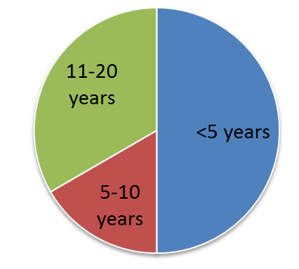
The Mentoring program for beginning teachers
PARTICIPANTS
COORDINATOR
6 first-year teachers (Mentees)
6 veteran teachers (Mentors)
All female teachers
ACADEMIC MANAGER OF DIVISION 2
Figure 1 Mentors' teaching experience

Slide 20
The Mentoring program for beginning teachers
Implementation

Slide 21
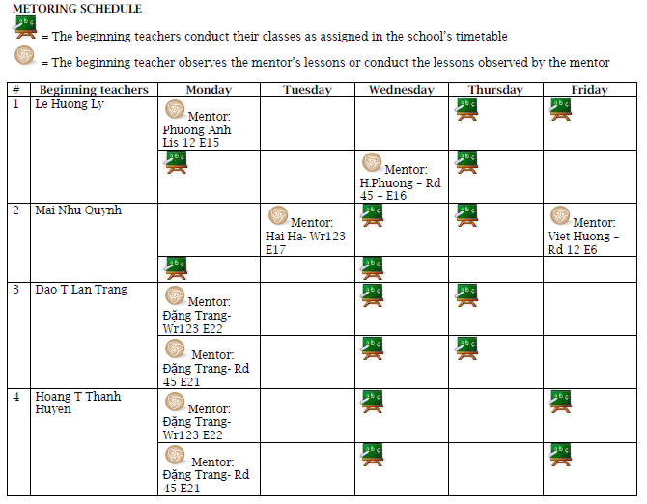

Slide 22
The Mentoring program for beginning teachers
Compulsory Mentoring Activities as reported by the program coordinator
Mentor giving feedback on mentee’s lesson plans
Observing each other’s classes as scheduled
Giving feedback on teaching methodology and class management
Mentee writing reflections after each class observation
Mentor writing evaluation about mentee’s performance and reporting to the program coordinator
Length: 1 academic year
→ How to make the program more effective? How to make the program meet the needs of the teachers better?

Slide 23
EVALUATION APPROACH?

Slide 24
EVALUATION APPROACHES (OWEN, 2003)
Proactive
synthesis
Is there a need for the program?
Clarificative
clarification
What are the intended outcomes and how is the program designed?
Interactive
improvement
How could delivery change to make the program more effective?
Checking/ Accountability
Impact
Monitoring
Is implementation reaching the program benchmark?
Learning/ Accountability
What are the outcomes of the program?

Slide 25
Interactive evaluation
Dimension | Properties
Orientation | Improvement of program already being delivered
Typical issues | 1) What was the program trying to achieve? 2) Was the delivery working? 3) Was delivery consistent with the program plan? 4) What can be done to improve the program for the future?
State of the program | Under initial implementation, or subject to continuous review and improvement
Major focus | Findings could influence changes in the program plan and thus affect outcomes
FIT

Slide 26
RESEARCH METHODOLOGY

Slide 27
Research methodology
Types of data | Instruments | Collection procedure | Data analysis
Descriptive indicators of the programs | Program description, mentees’ lesson plans, reflections Mentors’ class observation feedback sheet, written reports | Vis-à-vis the program | Content analysis
Participants’ feedback of the program | Survey questionnaires (70 items - close-, open-ended questions, Likert rating scale) | Survey administration at the end of the program (100% response rate) | -Content analysis (open questions) -Statistical analysis (ordinal data)

Slide 28
Survey instrument
What was the program trying to achieve? | whether the program participants shared a common understanding of the program’s objectives, how relevant the program’s objectives were to participants’ personal goals.
Was the delivery working? | participants’ general satisfaction, their perceptions and evaluation of the program activities, their perception and evaluation of organisational support.
Was the delivery consistent with the program plan? | Did the planned activities occur? What contents did the mentoring cover, and how effective they were according to the mentors and mentees? Program achievement
What can be done to improve the program in the future? | perceptions of the program’s strengths areas of improvement suggestions for improvement.

Slide 29
DATA ANALYSIS AND FINDINGS

Slide 30
Research questions
1) What was the program trying to achieve?
2) Was the delivery working?
3) Was delivery consistent with the program plan?
4) What can be done to improve the program for the future?

Slide 31
What was the program trying to achieve?

Slide 32
1. What was the program trying to achieve?
The program objectives were not described officially in written form
Perceived goals are mainly towards Mentees (+) and sharing culture (+)

Slide 33
Mentoring program objectives as perceived by the mentors and the mentees
Objectives | Mentees’ responses | Mentors’ responses
Objectives related to mentees
a. To provide professional support for mentees (teaching methodologies, lesson preparation, class management) | 6/12 | 6/15
b. To develop mentees’ attitude (confidence, responsibility) | 1/12 | 1/15
c. To inform mentees of the current teaching programs and practices in the division | 1/12 | 1/15
Objectives related to mentors
d. To develop self-reflecting practice for mentors | 1/12 | 1/15
Objectives related to division
e. To promote a sharing culture (through sharing experience, peer observation) | 3/12 | 3/15
f. To collect evidence for teacher performance management | 0/12 | 2/15
g. To facilitate professional development for the division | 0/12 | 1/15

Slide 34
Mentoring program objectives as perceived by the mentors and the mentees
Best perceived objective: “to support the mentees to develop professionally“
considerable level of consistency about the fundamental objective of the program
strong relevance between the perceived program objectives and the personal goals of the participants.
Failure to acknowledge the objectives related to the mentees’ attitude, mentors’ benefits, and management responsibilities.

Slide 35
2. Was the delivery working?

Slide 36
2. Was the delivery working?
Participants’ general satisfaction,
Participants’ evaluation of program activities,
Participants’ evaluation of organisational support

Slide 37
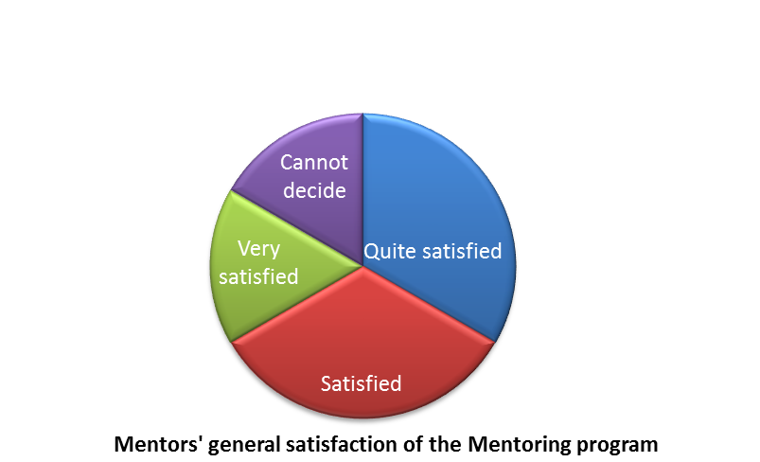
General level of satisfaction

Slide 38
program activities
Evaluation of the program activities’ effectiveness
“Rate the helpfulness of the activities that you think are included in the program,”
Missing values indicated the number of participants negating the existence of the activity in the program.

Slide 39
Program activities
Activities with no missing values
 | Mentees’ rating | Mentors’ rating
giving feedback on lesson plans* | 3.50 | 3.83
class observation* | 3.83 | 3.67
feedback sessions after class observation | 4.00 | 3.67
monitoring the practice of mentors and mentees
surveying needs of beginning teachers
reflective practice

Slide 40
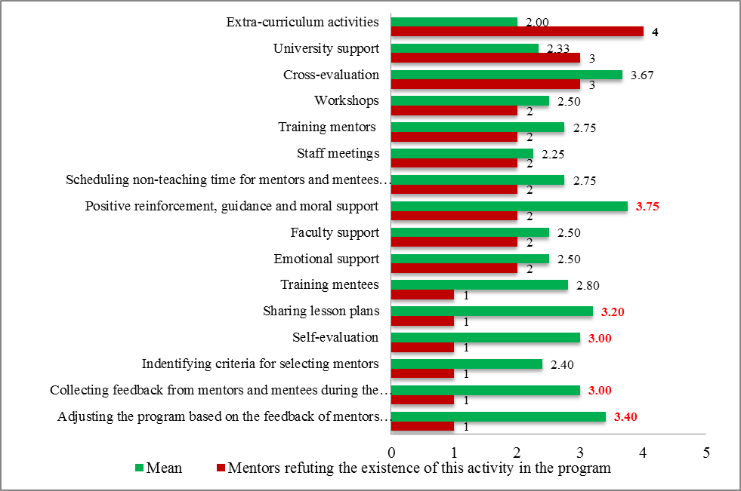

Slide 41
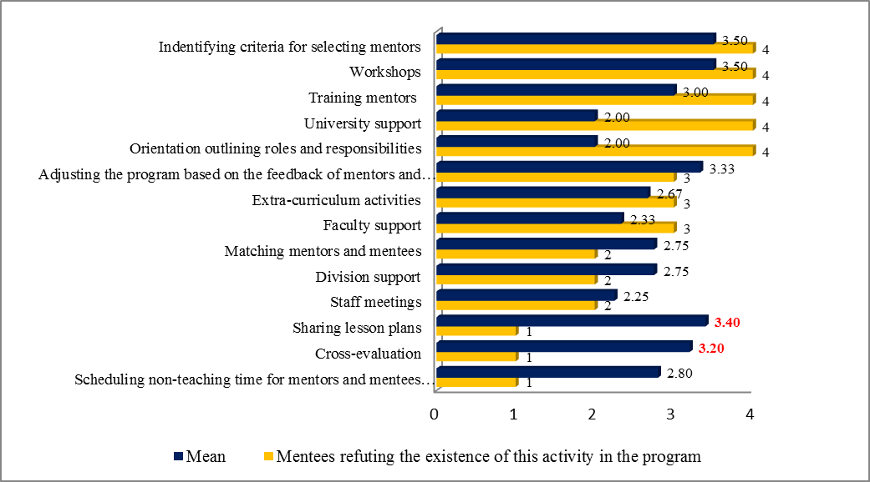

Slide 42
program activities
Activities with missing values
Inconsistency
Contrasting pattern of response between mentors and mentees
gap in their perception of the program between the two groups of participants, and within each group.
only 5/16 and 2/14 rated helpful/ very helpful
Mentors | positive guidance and moral support between them and the mentees* (3.75), adjusting the program based on their feedback (M=3.4), sharing lesson plans* (M=3.2), collecting their feedback during the program implementation* (M=3), and self-evaluation* (M=3).
Mentees | sharing lesson plans* (M=3.4) and cross-evaluation (M=3.2)

Slide 43
program activities
Mentees’ comments
The class observations provided me with the chance to learn from my mentors in terms of teaching method, the activities, the class discipline and their flexibility. From what I learned, I improved my own lessons. For instance, some of the activities I learned from my mentor were applied in my lesson and I realized that the students were more enthusiastic in the lessons. The feedback session helped me improve my effectiveness as a teacher. They helped me realize my strengths and weaknesses. For example I once received the comment I did not give my students enough time to answer my questions. Then I paid more attention to that, allowing more time and seeing them more involved in the lessons. The reflections also help me improve my effectiveness as a teacher. I had chance to look at my lessons again, seeing what I have done and what I could not complete. After each reflection I gained lessons for myself and applied that into the next lessons.

Slide 44
organisational support
Support provider | People refuting the existence of this support | Mean | Mode | Std. Deviation | Variance | Min | Max
Division Leader | 1 | 3.36 | 3ª | .674 | .455 | 2 | 4
Your mentor/ Your mentee | 0 | 3.33 | 4 | .778 | .606 | 2 | 4
Other senior teachers | 4 | 3.25 | 4 | .886 | .786 | 2 | 4
Other beginning/ junior teachers | 3 | 2.56 | 3 | 1.130 | 1.278 | 1 | 4
Faculty Leaders | 4 | 2.00 | 2 | .926 | .857 | 1 | 4
University Leaders | 6 | 1.50 | 1ª | .548 | .300 | 1 | 2
Other Administrators at the Uni level | 6 | 1.50 | 1ª | .548 | .300 | 1 | 2
Faculty Admin Office | 5 | 1.43 | 1 | .535 | .286 | 1 | 2
Table 2 Perception and evaluation of organisational support

Slide 45
Evaluation of program delivery as a whole
Program Delivery | Mean | Mode | Std. Deviation | Variance | Min | Max
Activities between mentors and mentees during the program | 3.55 | 3.38ª | .267 | .071 | 3.13 | 4.00
Monitoring and evaluation activities | 3.2 | 3.40 | .529 | .280 | 2.40 | 3.80
Preparation for the program | 2.38 | 2.00ª | .368 | .135 | 2.00 | 2.88
Organisational support | 2.03 | 1.85ª | .160 | .026 | 1.85 | 2.15
Table 3 Evaluation of four criteria of program delivery

Slide 46
Evaluation of program delivery as a whole
Positive aspects
Helpful interaction and activities between mentors and mentees, particularly those directly supporting mentees’ teaching skills
the monitoring and evaluation activity and the role of the division head as the program coordinator.
Areas of concerns
Divergence in understanding and experience of the program
Low satisfaction with the preparation for the program and the organisational support, especially the support from the university and administration staff

Slide 47
3. Was delivery consistent with the program plan?

Slide 48
3. Was delivery consistent with the program plan?
Did the planned activities occur?
What contents did the mentoring cover, and how effective they were according to the mentors and mentees?
What has the program achieved?

Slide 49
3. Was delivery consistent with the program plan?
Did the planned activities occur?
8/12 said ‘Yes’
The disparity questioned the consistency in communicating and implementing the program to its participants.

Slide 50
3. Was delivery consistent with the program plan?
Mentees
All the mentoring contents were satisfactory
provision of resources to meet students’ needs (N=5, M=3.60), mentoring on curriculum (N=6, M=3.50), time management (N=6, M=3.50), understanding of professional expectations (N=5, M=3.40).
mentees’ experience did not resemble each other
Mentors
mentors were not as contented
reflection management (N=6, M=2.67), student assessment (N=6, M=2.60), teacher-student communication (N=5, M=2.60), developing individual PD plan (N=3, M=2.67), and understanding the faculty community
deviated in reporting and evaluating mentoring contents.

Slide 51
3. Was delivery consistent with the program plan?
Mentees
All the mentoring contents were satisfactory
provision of resources to meet students’ needs (N=5, M=3.60), mentoring on curriculum (N=6, M=3.50), time management (N=6, M=3.50), understanding of professional expectations (N=5, M=3.40).
mentees’ experience did not resemble each other
Mentors
not as contented as the mentees
reflection management (N=6, M=2.67), student assessment (N=6, M=2.60), teacher-student communication (N=5, M=2.60), developing individual PD plan (N=3, M=2.67), and understanding the faculty community
deviated in reporting and evaluating mentoring contents.

Slide 52
3. Was delivery consistent with the program plan?
Mentoring areas (Duron, 2000; Hope, 2001) | Valid | Mean | Mode | Std. Deviation | Variance | Minimum | Maximum
Professional support – Teaching and Classroom Management | 10 | 3.2750 | 3.00 | .39878 | .159 | 2.75 | 4.00
Beginning Teachers’ Wellbeing | 8 | 3.2188 | 3.00 | .43172 | .186 | 2.50 | 3.75
Professional support – Curriculum and Assessment | 8 | 3.1250 | 3.25ª | .65465 | .429 | 1.75 | 3.75
Acculturation | 5 | 3.0000 | 2.20ª | .70711 | .500 | 2.20 | 3.80
Professional support – Career Development | 5 | 2.8800 | 2.40ª | .41473 | .172 | 2.40 | 3.40

Slide 53
3. Was delivery consistent with the program plan?
Mentees
The program achieved its objectives and helped them achieve their personal goals.
The program soothed mentees’ transition to the new teaching position
They also gained job motivation, familiarity with teaching materials and philosophy, and class management
Mentors
the program achieved its goals and helped them achieve their personal objectives.
development of self-reflection practice and learning from the new teachers
sense of “being a useful resource,” “refresh[ing] the classroom atmosphere,” “improving teaching and working philosophy” and “getting to know new” colleagues.

Slide 54
3. Was delivery consistent with the program plan?
Positive aspects
the consistency of the program implementation with its plan,
no strong evidence of any activity failing the initial plan,
Achievement of the program goals and personal goals were confirmed to have been achieved,
high satisfaction of the professional support to mentees, especially in teaching and class management.
Areas of concerns
disparity in mentors’ and mentees’ experience and evaluation,
low opinions of mentoring support for the acculturation process and professional development strategies for the mentees.

Slide 55
4. What can be done to improve the program for the future?

Slide 56
4. What can be done to improve the program for the future?
Retaining the current strengths
Supportive attitude of both the mentors and mentees that made them comfortable working together.
Effective role of the program coordinator who built up a “well-organised” and “schedule[d]” program, and created a “friendly sharing culture” in the division as the division leader.
Areas for improvement
time constraint for the mentoring activities, lack of incentives for the mentors and monitoring of mentees’ commitment.
Suggested solutions
fewer teaching assignments, reward system for mentors, “stricter” supervision of mentees’ participants, mentor training

Slide 57
DISCUSSION AND RECOMMENDATIONS

Slide 58
Discussion and recommendations
1. Disparity in participants’ understanding and evaluation of the program
2. Benefits of the mentoring program
3. Problems of the mentoring program
4. Other recommendations for future programs

Slide 59
Discussion and recommendations
1. Disparity in participants’ understanding and evaluation of the program
Communication
Monitoring
Mentor training
Making information about the program known and transparent before the mentoring starts is vital to the program effectiveness (Barrera, Braley and Slate 2010, p. 71),

Slide 60
Discussion and recommendations
1. Disparity in participants’ understanding and evaluation of the program
Communication
Monitoring
Mentor training
regularly supervise the proximity between the mentor and mentee, the mentor’s behaviour and the mentee’s reflective practice
constantly observe or collect feedback about the mentor’s behaviour and provide timely interventions if necessary.
critical reflection with deep “theoretical” insights into the principles behind the practice was sometimes overlooked during the mentoring process (Hobson, et al., 2009, p. 210)

Slide 61
Discussion and recommendations
1. Disparity in participants’ understanding and evaluation of the program
Communication
Monitoring
Mentor training
mentor preparation tends to boost the mentors’ efficiency and positive influence on the protégés (Evertson & Smithey, 2000; Hobson, et al., 2009)

Slide 62
Discussion and recommendations
2. Benefits of the mentoring program
Found out that program outcomes were better received by the mentees than the mentors, which is similar to Ehrich, et al. (2004)
supported previous findings that the most important gains for mentors were “collegiality and networking” and reflection practice, whereas for mentees were the professional support for their teaching and emotional support from the mentors(Ehrich, et al., 2004, p. 524).
Reaffirmed that both the mentors and mentees benefited from the sharing and peer-learning in the program.

Slide 63
Discussion and recommendations
3. Problems of the mentoring program
confirmed time constraint as the most commonly cited problem of mentoring program (Ehrich, et al., 2004).
No clear evidence for the second most frequently cited issue in previous research - “professional expertise and/or personality mismatch” - indirect culture in the Vietnamese workplace?

Slide 64
Discussion and recommendations
4. Other recommendation for future programs
Well-planned objectives
Mentor selection
Organisational support

Slide 65
Discussion and recommendations
4. Other recommendation for future programs
Well-planned objectives
Mentor selection
Organisational support
at least three years of “successful teaching” the same subject or grade level with the mentees (Barrera, et al., 2010; Brown, 2003, p. 20; Hobson, et al., 2009).
essential skills for quality mentoring include modelling good professional strategies, working cooperatively, time management and interpersonal skills (Brown, 2003, p. 20).
mentor’s positive personality
Older and same gender (Rebore, 2004).

Slide 66
Discussion and recommendations
4. Other recommendation for future programs
Well-planned objectives
Mentor selection
Organisational support
McCann and Johannessen (2004) reported, “If the time required to participate in the program represents an additional burden on the beginning teacher, then the activities become counterproductive” (p.144).

Slide 67
Conclusion
Interactive program evaluation form (Owen, 2006) to evaluate and improve the delivery of a newly developed mentoring program at the division level at a university in Vietnam.
Positive aspects
the program was highly relevant to the participants’ professional goals
mentoring activities were helpful to both mentors and mentees in achieving these goals, especially those related directly to developing mentees’ teaching skills and professional relationship.
effective function of the program coordinator in organising the program effectively, and as the division head, promoting a friendly sharing culture in the division.

Slide 68
Conclusion
Major concerns
Discrepancy in the participants’ understanding and experience of the program
Inadequate attention to the mentoring activities to familiarise novice teachers with the working context and to help them develop professional development strategies
Insufficient and inefficient organisational support from the university, faculty leaders and administration staff
Key Recommendations
Retaining its current advantages
Organisational support: fewer teaching time, better recognition and incentives
Communication
Monitor of the participants’ commitment and organising mentor training
Better-planned objectives
Mentor selection and training

Slide 69
References
Anthony, J. (2009). Teacher retention: Program evaluation of a beginning teacher and mentor program. Ed.D. 3354873, Gardner-Webb University, United States -- North Carolina. Retrieved from http://proquest.umi.com/pqdlink?did=1745453601&Fmt=7&clientId=14623&RQT=309&VName=PQD
Barrera, A., Braley, R. T., & Slate, J. R. (2010). Beginning teacher success: an investigation into the feedback from mentors of formal mentoring programs. Mentoring & Tutoring: Partnership in Learning, 18(1), 61 - 74.
Beck, C., & Kosnik, C. (2000). Associate Teachers in Pre-service Education: clarifying and enhancing their role. Journal of Education for Teaching, 26(3), 207-224.
Berk, R. A. (2005). Measuring the effectiveness of faculty mentoring relationships. Academic medicine, 80(1), 66.
Brown, S. (2003). Working Models: Why Mentoring Programs May be the Key to Teacher Retention. Techniques, 78(5), 18.
Bullough, J. R. V. (2005). Being and becoming a mentor: school-based teacher educators and teacher educator identity. Teaching and Teacher Education, 21(2), 143-155.
Duron, J. I. (2000). An evaluation study of the effectiveness of a teacher induction program. Ed.D. 9975724, Baylor University, United States -- Texas. Retrieved from http://proquest.umi.com/pqdlink?did=731940261&Fmt=7&clientId=14623&RQT=309&VName=PQD
Ehrich, L. C., Hansford, B., & Tennent, L. (2004). Formal mentoring programs in education and other professions: A review of the literature. Educational administration quarterly, 40(4), 518-540.
Evans, L., & Abbott, I. (1997). Developing as mentors in school-based teacher training. Teacher Development: An international journal of teachers’ professional development, 1(1), 135 - 148.
Evertson, C. M., & Smithey, M. W. (2000). Mentoring Effects on Proteges' Classroom Practice: An Experimental Field Study. Journal of Educational Research, 93(5), 294.
Gregson, J. A., & Piper, J. W. (1993). The Ohio induction process: Perceptions of beginning secondary school trade and industrial teachers. Journal of Industrial Teacher Education, 30(2), 30-43.
Hobson, A. J., Ashby, P., Malderez, A., & Tomlinson, P. D. (2009). Mentoring beginning teachers: What we know and what we don't. Teaching and Teacher Education, 25(1), 207-216.
Hope, L. L. (2001). The effects of a formal mentoring program on teacher retention and benefits to proteges and mentors. M.Ed. MQ60847, Lakehead University (Canada), Canada. Retrieved from http://proquest.umi.com/pqdlink?did=727331491&Fmt=7&clientId=14623&RQT=309&VName=PQD

Slide 70
References
Ingersoll, R. M., & Strong, M. (2011). The Impact of Induction and Mentoring Programs for Beginning Teachers. Review of Educational Research, 81(2), 201-233.
Lopez-Real, F., & Kwan, T. (2005). Mentors' perceptions of their own professional development during mentoring. Journal of Education for Teaching, 31(1), 15-24.
Maguire, M. (2001). Bullying and the Postgraduate Secondary School Trainee Teacher: an English case study. Journal of Education for Teaching, 27(1), 95-109.
McCann, T. M., & Johannessen, L. R. (2004). Why Do New Teachers Cry? Clearing House, 77(4), 138-145.
Mitchell, D., & Scott, L. (1998). The California Beginning Teacher Support and Assessment Program: 1998 statewide evaluation study. Retrieved from
Owen, J. M. (2006). Program Evaluation Forms and Approaches (3rd ed.). Crown Nest: Allen&Unwin.
Rebore, R. W. (2004). Human Resources Administration in Educationa: A Management Approach (7th ed.). New York: Pearson Education.
Rivkin, S. G., Hanushek, E. A., & Kain, J. F. (2005). Teachers, Schools, and Academic Achievement. Econometrica, 73(2), 417-458.
Savage, H. E., Karp, R. S., & Logue, R. (2004). Faculty mentorship at colleges and universities. College Teaching, 52(1), 21-24.
Simpson, T., Hastings, W., & Hill, B. (2007). 'I knew that she was watching me': the professional benefits of mentoring. Teachers & Teaching, 13(5), 481-498.
Smith, T. M., & Ingersoll, R. M. (2004). What Are the Effects of Induction and Mentoring on Beginning Teacher Turnover? American Educational Research Journal, 41(3), 681-714.
Stöcklin, S. (2010). The Initial Stage of a School’s Capacity Building. Educational Management Administration & Leadership, 38(4), 443-453.
Stroot, S. A., Fowlkes, J., Langholz, J., Paxton, S., Stedman, P., Steffes, L., & Valtman, A. (1999). Impact of a collaborative peer assistance and review model on entry-year teachers in a large urban school setting. Journal of Teacher Education, 50, 27–41.

Slide 71
Thank you for your listening.
Vu Thi Phuong Thao (phuongthao.ulis@gmail.com)
University of Languages and International Studies,
Viet Nam National University, Ha Noi.
Ngo Viet Ha Phuong (phuonguq@yahoo.com)
University of Languages and International Studies,
Viet Nam National University, Ha Noi.

